Slide 1

HCI/UX
ANSHIKA ANSHIKA, AVINASH AVINASH, AUSTIN THOMPSON

Slide 2

WHAT IS HCI?
  Human Computer Interaction
  “A multidisciplinary field of study focusing on the design of computer technology and, in particular, the interaction between humans (the users) and computers” - Interaction Design Foundation
  HCI is a broad field which overlaps with areas such as user-centered design (UCD), user interface (UI) design and user experience (UX) design.

Slide 3
Brief History of HCI
  1970s- The rise of the Personal Computer.
  1980s- Graphical User Interface (GUI)
  1990s- The Internet and Collaborative works.
  2000s- Mobile Computing and Beyond.

Slide 4
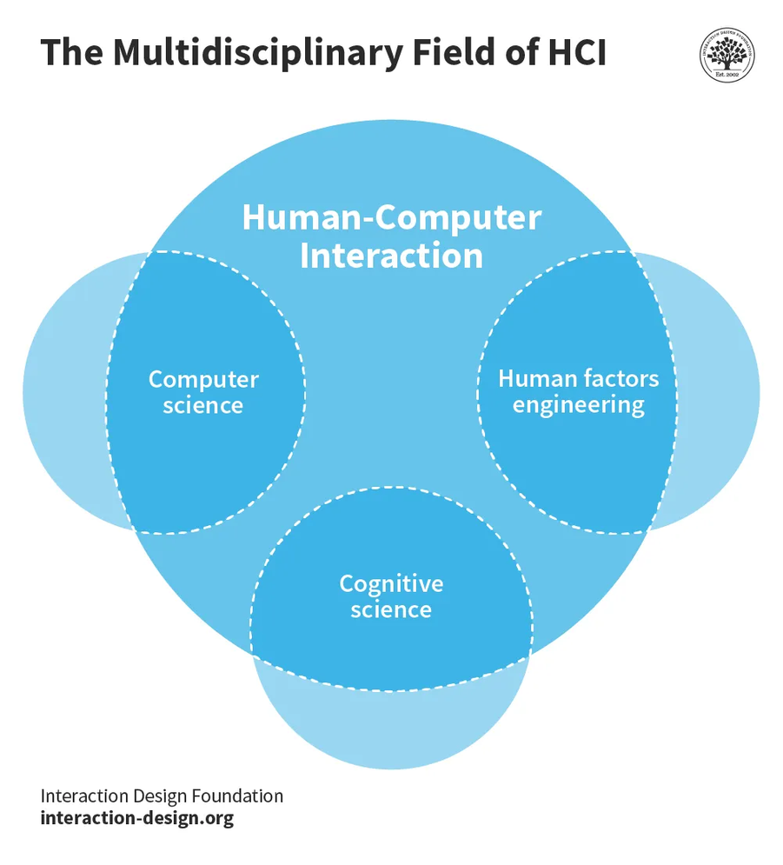
“…it no longer makes sense to regard HCI as a specialty of computer science; HCI has grown to be broader, larger and much more diverse than computer science itself. HCI expanded from its initial focus on individual and generic user behavior to include social and organizational computing, accessibility for the elderly, the cognitively and physically impaired, and for all people, and for the widest possible spectrum of human experiences and activities. It expanded from desktop office applications to include games, learning and education, commerce, health and medical applications, emergency planning and response, and systems to support collaboration and community. It expanded from early graphical user interfaces to include myriad interaction techniques and devices, multi-modal interactions, tool support for model-based user interface specification, and a host of emerging ubiquitous, handheld and context-aware interactions.”
— John M. Carroll, author and a founder of the field of human-computer interaction.

Slide 5
WHAT IS UX?
  User Experience (UX) Design - An Iterative Process
  “A person's perceptions and responses that result from the use or anticipated use of a product, system or service.” - International Organization for Standardization
  User experience (UX) focuses on having a deep understanding of users, what they need, what they value, their abilities, and also their limitations.

Slide 6
Brief History of UX
  4000 BC: Feng Shui and UX
  1940s: Toyota Production System
  1950s: Henry Dreyfuss and the art of designing for people
  1970s: Xerox, Apple, and the PC era
  1990s: Don Norman and the term "UX"
  Early 2000s: the first iPhone
  Today is history in the making

Slide 7
“No product is an island. A product is more than the product. It is a cohesive, integrated set of experiences. Think through all of the stages of a product or service – from initial intentions through final reflections, from the first usage to help, service, and maintenance. Make them all work together seamlessly.” - Don Norman, inventor of the term “User Experience”

Slide 8
Factors that Influence UX
  Useful: Your content should be original and fulfill a need
  Usable: Site must be easy to use
  Desirable: Image, identity, brand, and other design elements are used to evoke emotion and appreciation
  Findable: Content needs to be navigable and locatable onsite and offsite
  Accessible: Content needs to be accessible to people with disabilities
  Credible: Users must trust and believe what you tell them

Slide 9
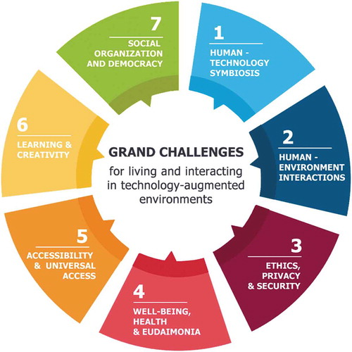
What Problems Do They Solve?

Slide 10
  Human-Technology Symbiosis : ​
  Co-existence and interactions of two counterparts: humankind and intelligent computer systems
  Introduced by Licklider in 1960s as a future when human brains and computing machines – tightly coupled together – would “think as no human brain has ever thought and process data in a way not approached by the information-handling machines we know today”.
2. Human-Environment Interaction : ​
  “Designing relations between humans and the world, and, ultimately designing the character of the way in which we live our lives” - Verbeek, 2015.
  Computing devices are embedded in everyday artefacts as “disappearing computers” and interactions have advanced from keyboard-and-pointer to touch-and-gesturing.

Slide 11
3. Ethics, ​privacy and security :
  “Technological systems need to behave so that they are beneficial to people beyond simply reaching functional goals or addressing technical problems, by serving human rights and the values of their users, “whether our ethical practices are Western (e.g. Aristotelian, Kantian), Eastern (e.g. Shinto, Confucian), African (e.g. Ubuntu), or from a different tradition” - The IEEE, 2019.
4. Well-being, health and eudaimonia :
  Precision health aims to make healthcare more tailored to each person based on their individual differences, allowing individuals to individualize and optimize care over their lifespan.
  “Devices that are attached to, worn by, interacted with, or carried by individuals for the purposes of generating biomedical data and/or carrying out medical interventions on the person concerned” concern about users’ comfort, sensor unobtrusiveness, and signal quality .

Slide 12
5. Accessibility and Universal Access :
  Not a “One-size-fits-all” approach - Adopting a universal access approach.
  Individuals are at risk of exclusion: Race and ethnicity, gender, socioeconomic status, age, education, occupational status, health, social connectedness, and availability of infrastructures
6. Learning and Creativity :
  Push the boundaries of education towards other criteria beyond grades, such as motivation, confidence, enjoyment, satisfaction, and meeting career goals.
  A “copy and paste” attitude​ - Exploiting the wide range of information available on the web

Slide 13
7. Social organization and Democracy:
  Safeguard Social participation, social justice, sustainability, and stability.
  People have the potential to become “agents of democracy with and through technologies and in dialogue with the institutions that can actualize public will”.

Slide 14
Common Use Cases of HCI/UX
  Smart Homes
  Autonomous Vehicles
  Smart phones for Visual Disabilities

Slide 15
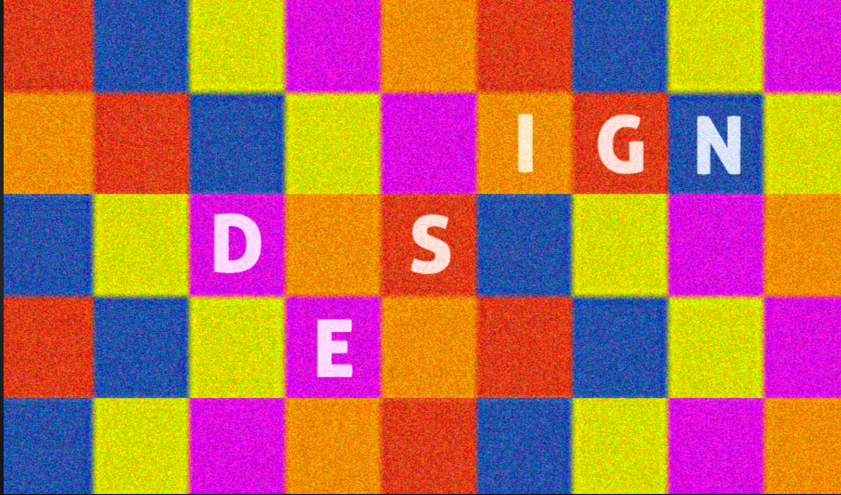

Design Approaches for Displays

Slide 16
Introduction
  Visual displays, along with auditory, tactile, etc., are designed to present information about a system. They act as portals for users to interact with technology.​
  Before designing a display, clearly define its purpose. Is it intended for navigation, control, decision-making, learning, entertainment, or something else? Understanding the task helps tailor the display to user needs.​
  Therefore, the information must be displayed according to principles in a manner that will support perception, situation awareness, and understanding.

Slide 17
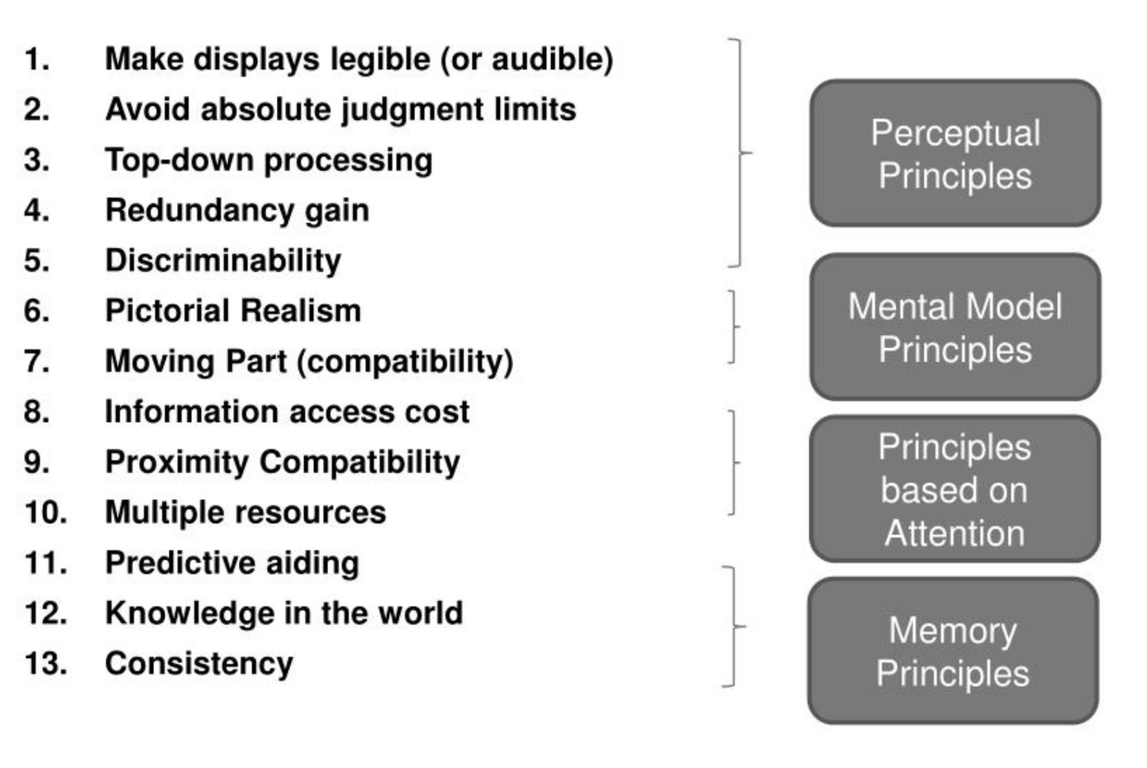
Wickens' thirteen principles​
​

Slide 18
Perceptual Principles
1. Make displays legible : ​
  If users can't see or understand the information being displayed, it's useless.​
  Avoid small fonts or bad handwriting that make perception difficult.
Light or faint text is often difficult to read.
2. Avoid absolute judgment limits :
  Avoid making the operator or user judge the represented variable level on the basis of a single sensory dimension (color, size, pitch, etc.)
  Example : --- --- --- --- ---

Slide 19
Perceptual Principles (contd..)
3. Similarity causes confusion: ​
  By minimizing similarity and emphasizing differences, users can easily distinguish between options and avoid confusion.
4. Top - down processing : ​
  It is a psychological concept that explains how our brains interpret information based on our past experiences and expectations. In simpler terms, “we often see what we expect to see.”
5. Redundancy gain :​
  By using redundancy strategically, we can design interfaces that are clearer, more reliable, and less prone to user errors.
  Example : Traffic light signals.

Slide 20
Principles Based on Attention
6. Minimize information access cost : ​
  Frequently used information should be readily available to avoid users jumping between displays.
7. Principle of multiple resources : ​
  A user can more easily process information across different resources.
8. Proximity Compatibility Principle : ​
  Related information should be grouped close together. This makes it easier for users to mentally connect the information and complete tasks.

Slide 21
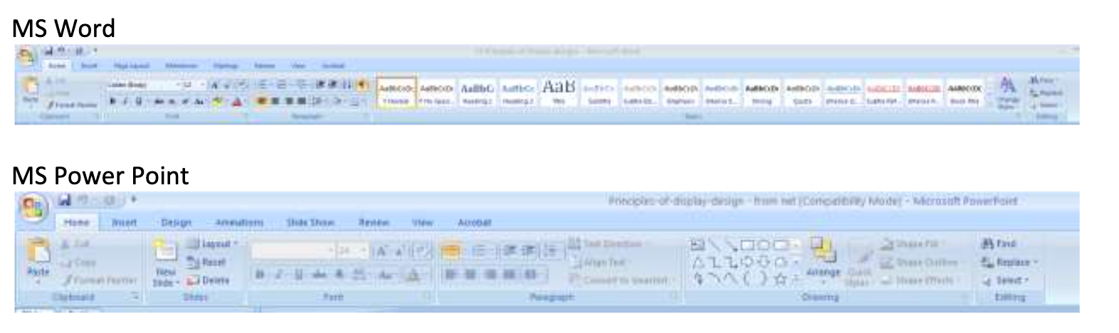
Principles Based on Memory
9. Principle of consistency : ​
  A user’s long-term memory will trigger actions that are expected to be appropriate. ​
  Familiar icons, actions and procedures from other displays will easily transfer to support processing of new displays if they are designed in a consistent manner. ​
  Example:

Slide 22
Principles Based on Memory (contd..)
10. Principle of predictive aiding : ​
  Show information before it's needed, allowing users to anticipate and plan ahead
  Example: GPS turn warnings.​
11. Replace memory with visual information:​
  A user should not need to retain important information solely in working memory (what one is currently thinking about) or to retrieve it from long-term memory(one’s permanent storage of memories).​
  A menu, checklist, or another display can aid the user by easing the use of their memory.

Slide 23
Principles Based on Mental Models
12. Principle of pictorial realism​:
  A display should look like the variable that it represents.
  Example : High temperature on a thermometer shown as a higher vertical level. ​
13. Principle of the moving part ​:
  Moving elements should move in a pattern and direction compatible with the user’s mental model of how it actually moves in the system. ​
  Example : The moving element on an altimeter should move upward with increasing altitude.

Slide 24
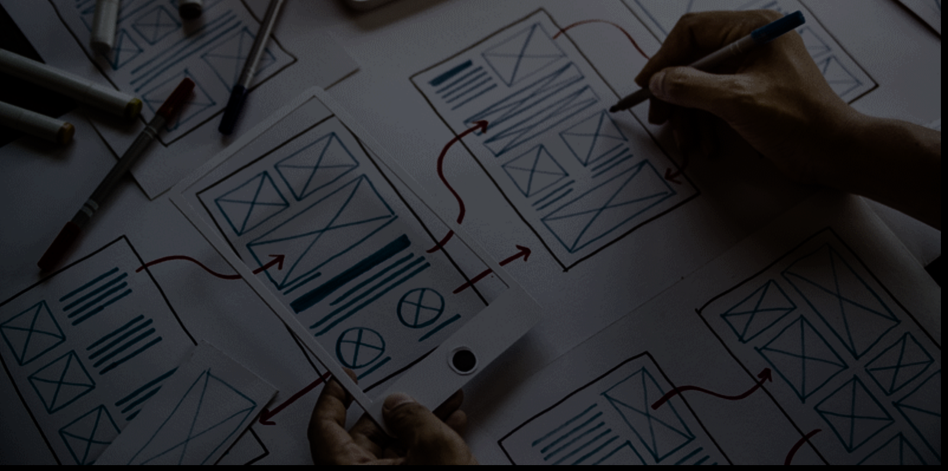
Prototyping
  Prototyping is creating a simplified, early version of a digital product or system to gather feedback and test design concepts.
​
  Prototyping is an essential step in the iterative design process, meaning it's used repeatedly to refine the design based on feedback.

Slide 25
Why do we need Prototyping ?
  User Feedback: Prototyping allows designers to gather feedback from users early in the design process.
  Communication: Prototypes serve as a communication tool between designers, developers, and stakeholders.
  Cost-Effective: Prototyping is often more cost-effective than developing a fully functional product.

Slide 26
Types of Prototyping
  Low-fidelity prototypes
  Medium-fidelity prototypes
  High-fidelity prototypes

Slide 27
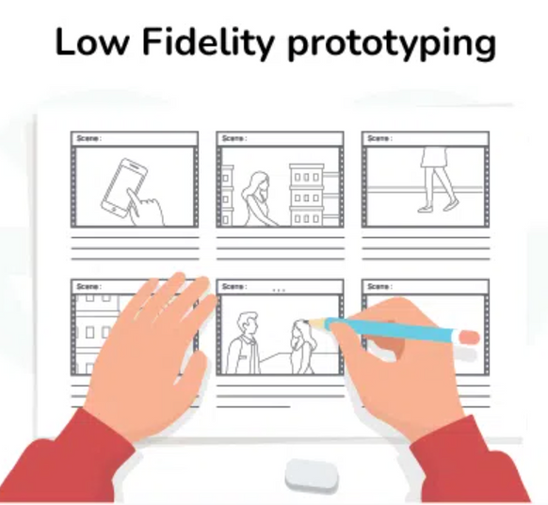
Low-Fidelity Prototyping
  Low-fidelity prototypes are quick and easy to create, often using simple tools like paper, markers, or digital wireframing software.
  They are ideal for early-stage ideation.
  They are cost-effective .
For example:
  A paper sketch of the app’s main screens, showing basic layout and navigation.

Slide 28
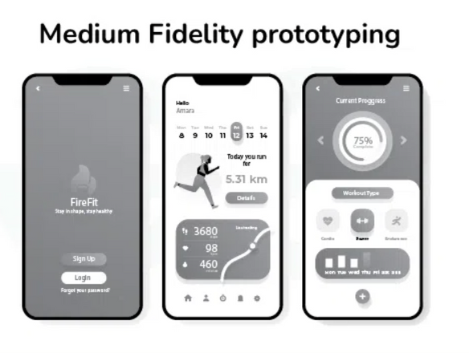
Medium-Fidelity Prototyping
  These are more detailed than low-fidelity prototypes.
  It’s not as basic as a simple drawing, but it’s also not as fancy as a fully finished product.
  They offer a balance between detail and speed, allowing designers to explore design ideas in more depth without investing too much time or resources.
For example:
  More detailed screens with basic interactive elements like buttons and links, but without actual content or graphics.

Slide 29
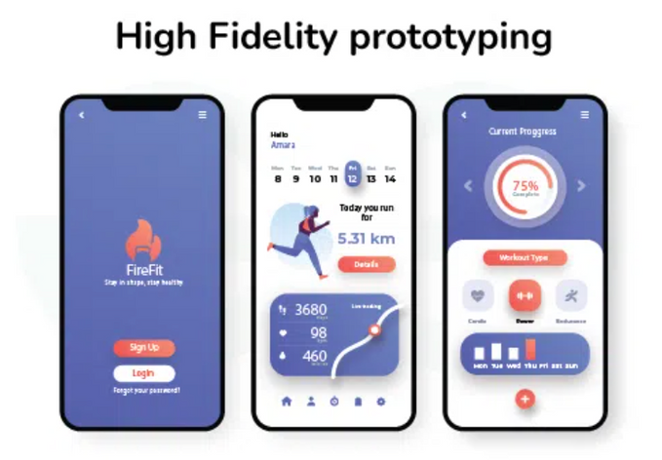
High-Fidelity Prototyping
  It is like creating a highly detailed and realistic version of your design idea.
  It closely resembles the final product in terms of appearance and functionality, but it’s not fully functional.
  They offer a more accurate representation of the final product.
For example:
  Fully designed screens with realistic content, graphics, and interactive elements that closely resemble the final app.

Slide 30
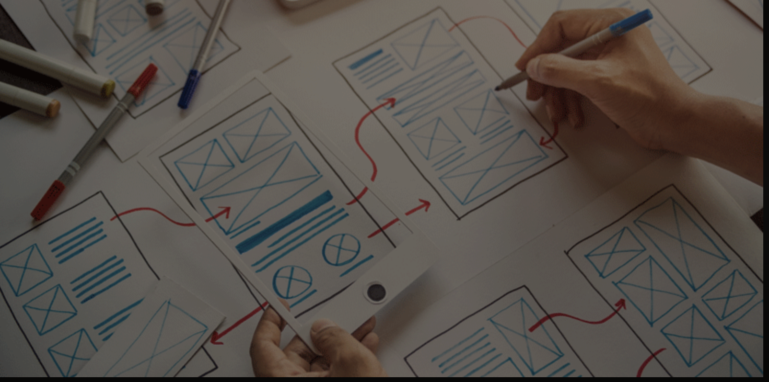
Evaluating a Design

Slide 31
Users and Tasks
  Identifying your Target Users:
  Demographics: Age, gender, location, technical expertise, etc.
  Behaviors: How do they currently use technology? What are their pain points and frustrations?
  Goals: What are they trying to achieve with your software? What problems are they trying to solve?

Slide 32
Users and Tasks (contd..)
2. Defining User Tasks:
  Core Tasks: What are the essential things users need to achieve with your software? (e.g., booking a flight, editing a document, managing finances)
  Sub-Tasks: Break down complex tasks into smaller, manageable steps. (e.g., searching for a flight, selecting travel dates, choosing a seat)
  User Context: Consider how and where users will be performing these tasks.

Slide 33
Task Analysis
  Task analysis is a method that helps you understand how users accomplish their goals and the steps they take to get there.

Slide 34
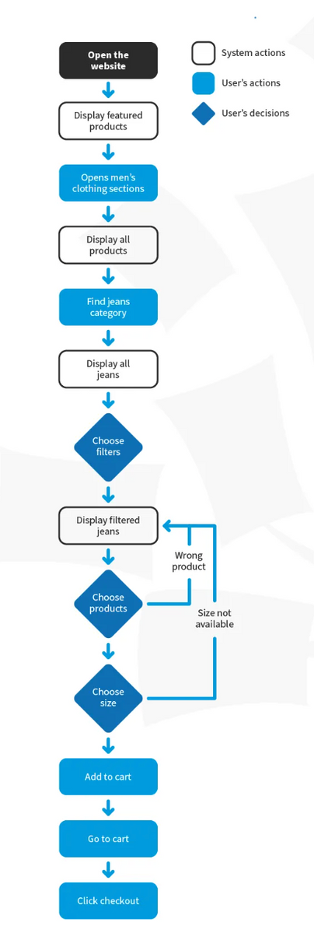
How to Conduct a Task Analysis
  Identify the Task You Need to Analyze.
  Break Down This Goal into Smaller Subtasks.
  Draw a Layered Task Diagram of each Subtask.
  Write the Story: Ensure you accompany your diagram with a narrative that focuses on the whys.
  Review the analysis with someone who wasn’t involved in the breakdown but knows the tasks well enough to check for consistency.

Slide 35
Measurement and Testing
  Here, you assess how well your design meets user needs and facilitates task completion.
  There are various methods to perform testing some of them are :
      Usability Testing
      User Surveys
      A/B Testing

Slide 36
Usability Testing
  Usability testing is a method of evaluating the usability of a digital product by observing users as they interact with it.
  The goal of usability testing is to identify user interface (UI) issues and usability problems, and to gather feedback on the user experience (UX) of the digital product.

Slide 37
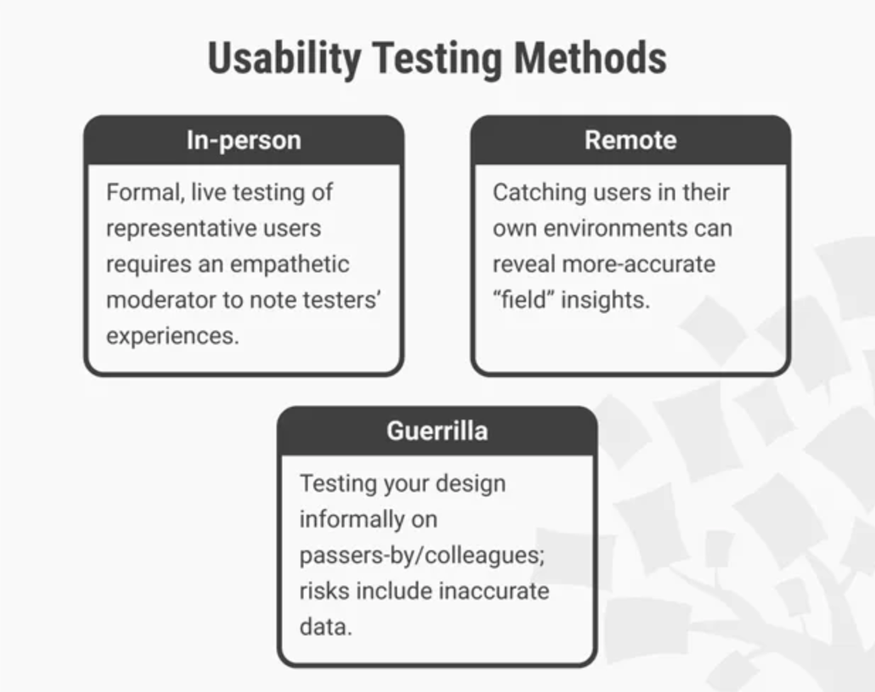
Usability Testing Methods

Slide 38
How to conduct a usability test?
  Usability Testing is an Iterative Process to make usability testing work best, you should:
      Define the goals and objectives of the usability test.
      Set user tasks –
        Prioritize the most important tasks to meet objectives
        Clearly define tasks with realistic goals.
        Create scenarios where users can try to use the design naturally.
      Recruit testers
      Facilitate/Moderate testing

Slide 39
User Surveys
  Surveys are a quick and efficient way to gather feedback from a large group of users.
  They're helpful for understanding user attitudes, preferences, and general behaviors related to the design.

Slide 40
A/B Testing
  This method compares two design variations (A and B) to see which one performs better.
  It provides statistically significant data on user behavior and is useful for optimizing specific elements like button placement or layout.
  A/B testing only tests specific variations, not the overall design concept.

Slide 41
Iterating the Design
  Iterating a design is the act of continuously creating, testing, and refining an aspect within a development process
  This process involves making incremental enhancements to a specific area in the development process such as:
    UI elements
    Functionality
    Requirements
  This process creates a end product that aligns more with the client’s needs
  Example:
    Data in graphs and charts may need to be adjusted to further improve the clarity or users understanding of the data according to the client’s needs

Slide 42
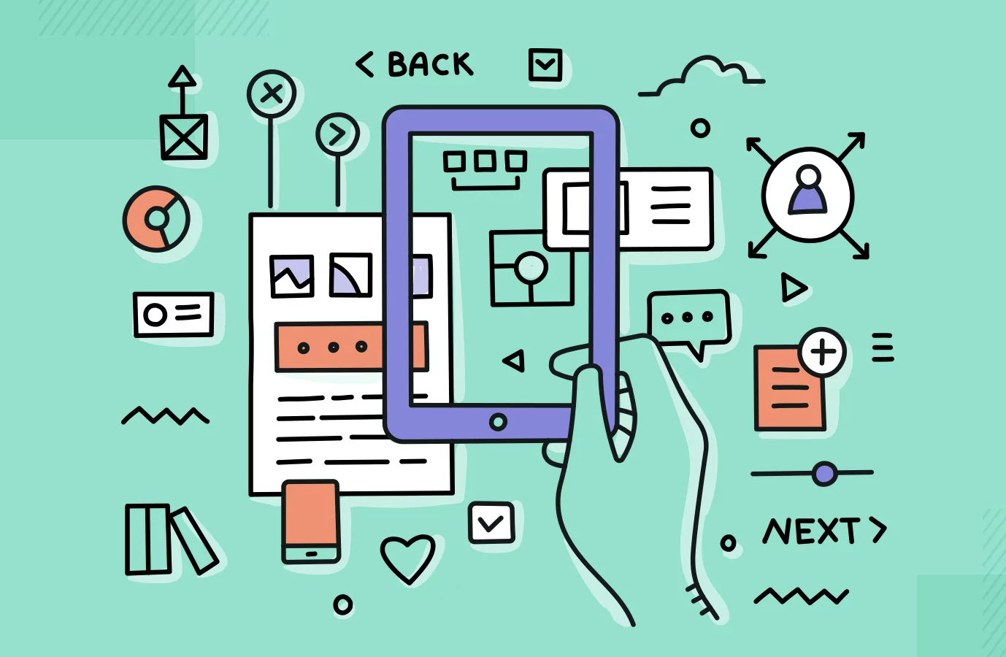
Agile and UX

Slide 43
Agile and UX
●Agile
  The iterative approach to software development that spotlights collaboration, user/customer satisfaction, and flexibility
  This form of development involves slicing a large project down into smaller, more manageable sections called sprints
●UX
  UX refers to the general experience that a given user has while interacting with a product or service.
  It surrounds all of the aspects of the user’s interactions and experiences with the product, company, and its services
  A streamlined user experience is very important for recurring customer retention. This encompasses the usability, accessibility, design, and performance of a product

Slide 44
Agile and UX design
  An Agile and UX design process creates user-centered result that is brought up by smooth communication between the developers, designers, and stakeholders that aids in the end product being user-centered.
  This approach to design is beneficial because it ensure the product is continuously improved upon because of Agile’s aspect of rapid testing and iteration. This leads to a more cohesive final product.

Slide 45
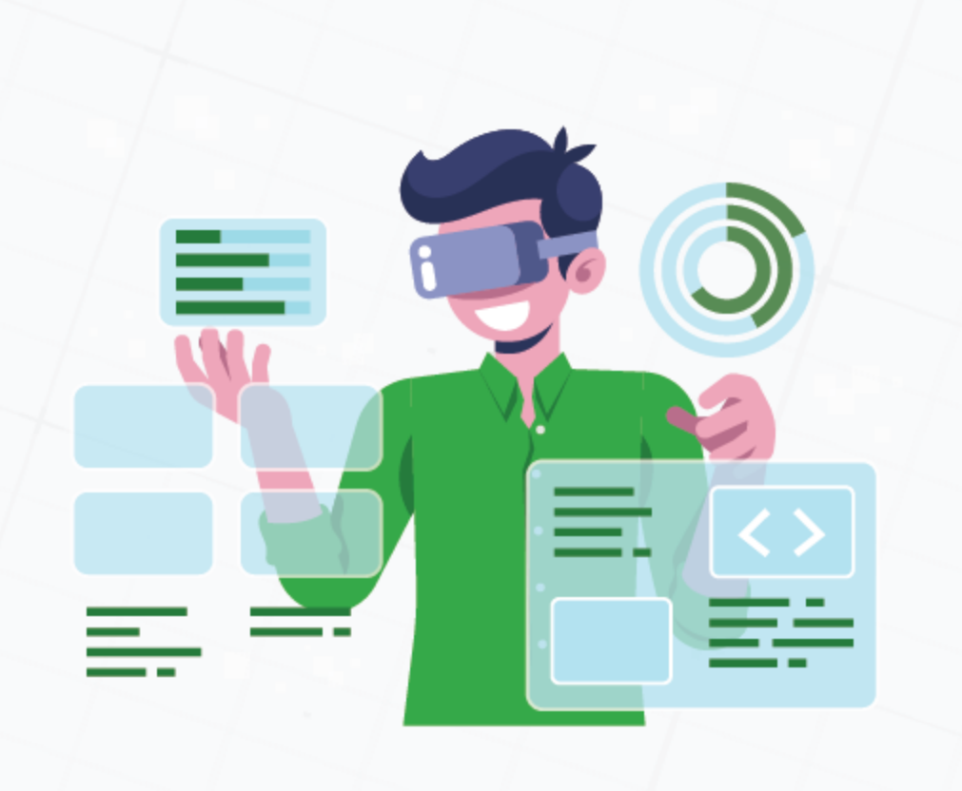
HCI
  Humam-Computer Interaction focuses on briding them gap between the user and the software that they are using.
  There multiple types of HCI including:
    Physical HCI
      Keyboard/Mouse
      Biometrics
      Touchscreens
      Controllers
    Digital HCI
      GUIs
      Gesture recognition
      BCI

Slide 46
Integrating HCI and UX with Agile framework
  Integrating HCI and UX processes into the agile framework includes adapting these design processes to fit within the iterative cycles of Agile development.
  This helps necessitate a collaborative approach where the HCI and the UX design teams work together. This helps to synchronize the efforts of each team to integrate user feedback iteratively.

Slide 47
Challenges of Integrating HCI and UX with Agile
  Lack of UX experience
    Agile development teams may not have dedicated UX professionals making it more difficult to implement UX practices properly.
  Time constraints
    Since agile is an iterative approach, it moves fast. This makes it challenging to accommodate time for HCI and UX testing and research
  Differing priorities
    The focus on agile delivery may lead to prioritizing features over the user experience

Slide 48
Benefits of Integrating HCI/UX with Agile
  Faster Adaptation to Feedback: UX teams can respond to user feedback faster using Agile due to its iterative approach.
  Ahead of clients' changing needs: Agile’s flexibility and adaptability allow teams to stay on top of the client’s ever-changing needs.
  Improved Satisfaction: According to Forbes, 50% of surveyed organizations reported that Agile’s approaches improved satisfaction with deliverables

Slide 49
Common Pitfalls and How to Overcome Them
  Mismanagement of Timelines: Agile sprints are time-sensitive, sometimes leading to a rushed design decision. To mitigate this, enough time must be allocated for UX design within each sprint.
  Lack of Communication: frequent communication between the UX and development teams is a critical step for the success of integrating UX into Agile.
  Not Enough User Feedback: User feedback is crucial to the UX design and Agile development process. This means that regular user testing should be a part of the Agile process to guarantee that the product is meeting and exceeding a user’s needs and/or expectations.

Slide 50
Responsive Web Design
  RWD is a web design approach that makes web pages appear and function correctly on different devices.
  It accounts for variations in screen size and screen resolution.
  Think of using a web browser on a desktop versus a phone.
    larger screen
    different resolution
    different HCI

Slide 51
Key Features of Responsive Web Design
  Fluid Grids: This involves designing a website’s layout using relative units such as percentages, rather than fixed units like pixels. This creates a more flexible and responsive layout.
  Flexible Images: Images are designed to adjust automatically based on the available space on the screen. This prevents them from causing layout issues on smaller devices.
  Media Queries: Media queries are CSS code snippets that let you define different styles for the website based on specific device characteristics.

Slide 52
The Viewport
  The viewport is the user’s visible area of a web page on a device. This is what the user can see on the page without scrolling horizontally or vertically.
  The viewport varies with different devices, such as a phone having a smaller viewport than a desktop because of its difference in screen size.
  HTML5 incorporated a method that allowed web designers to easily take control of the viewport with the <meta> tag.
    <meta name="viewport" content="width=device-width, initial-scale=1.0">

Slide 53
Advantages of Responsive Web Design
  Improved User Experience: Provides a more consistent user experience across different devices that ensures the website looks and functions similarly.
  Cost-Effective: without the use of RWD you might have different teams or websites that cater to each type of device
  Increased Reach: RWD allows your site to be accessible to nearly all users because of it’s flexibility, this increases the audience of your site.

Slide 54
References
  Interaction Design Foundation - IxDF. “What is Usability Testing?” Interaction Design Foundation - IxDF. 13 Mar. 2024 https://www.interaction-design.org/literature/topics/usability-testing
  https://studylib.net/doc/6912633/13-principles-of-display-designs
  https://www.tandfonline.com/doi/full/10.1080/10447318.2019.1619259
  https://www.geeksforgeeks.org/what-is-a-prototype-and-how-to-create-it/
  https://slickplan.com/blog/agile-ux
  https://www.interaction-design.org/literature/topics/human-computer-interaction#learn_more_about_human-computer_interaction-3
  https://www.geeksforgeeks.org/introduction-to-human-computer-interface-hci/#interaction-styles
  https://www.interaction-design.org/literature/topics/ux-design#ux_design%E2%80%94a_formal_definition-2

